Slide 1
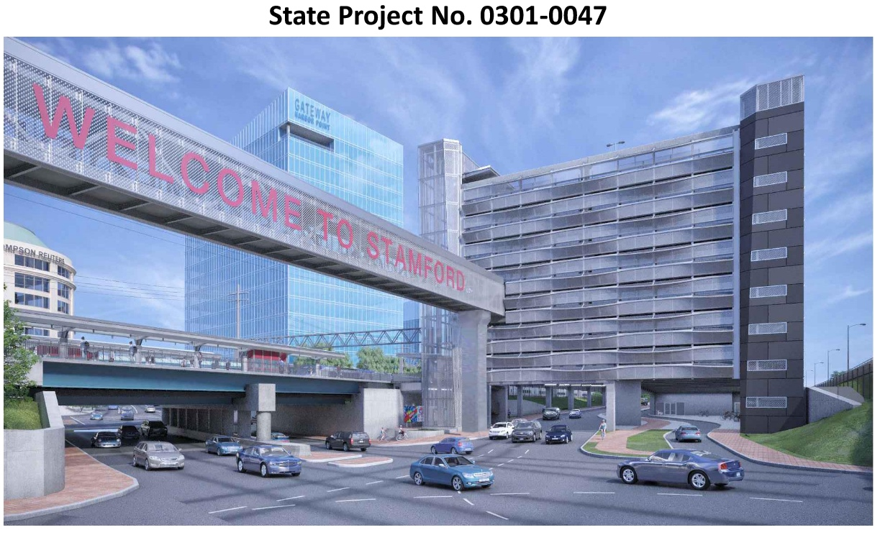
New Parking Garage
934 vehicle spaces
Covered lockable racks for 149 bicycles
Direct connection to platform at Track 5
Enclosed pedestrian bridge, directly connected to the STC
Design-Build Team: Yonkers Contracting Co. and Walker Parking Consultants
Construction Cost: $77.7m
Notice to Proceed: June 2021
Completion: Summer 2023

Slide 2
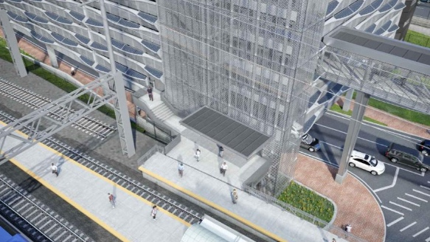
Platform Connection
3 All-Glass Elevators Inside and All-Glass Enclosure Tower
Direct Access to Existing Train Platform and South State Street

Slide 3
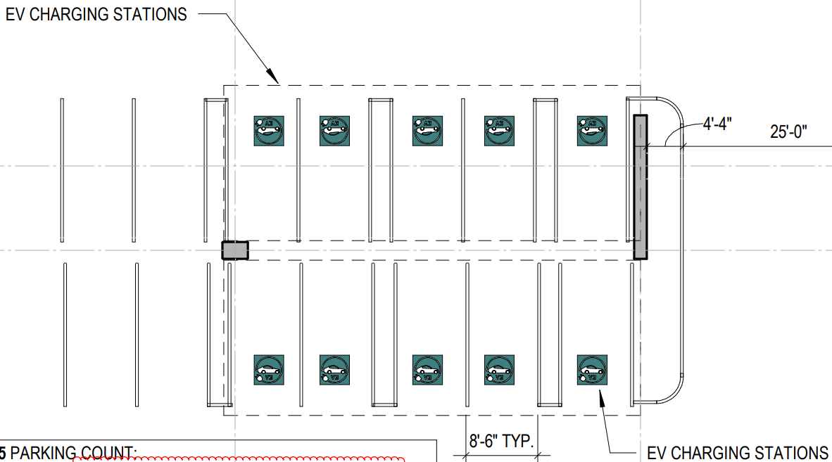
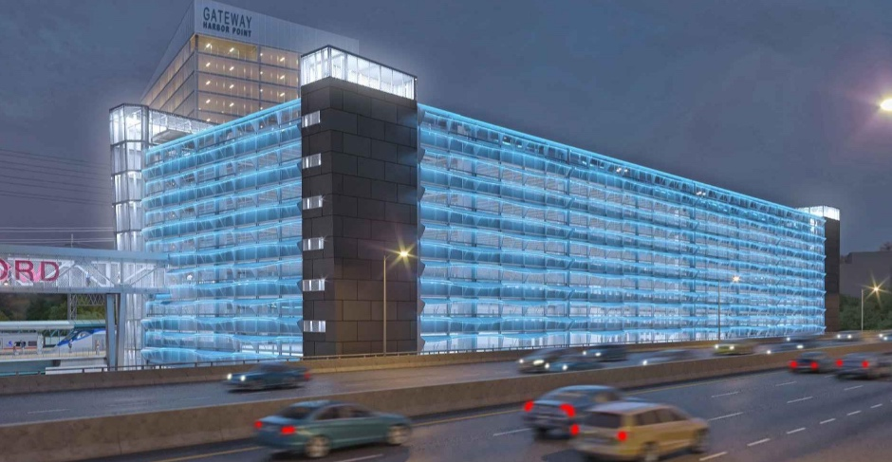
EV charging stations
38 Electric Charging Stations
3rd and 5th Levels

Slide 4
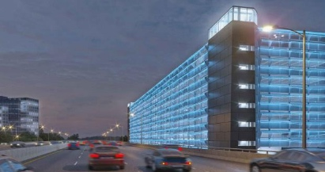
Basket Panels & Lighting
Illuminated Metal Baskets
LED Façade Lighting
Uniform, holistic glow across all four facades that can be color adjusted
Stair towers clad with glass fiber reinforced concrete (GFRC) panels

Slide 5
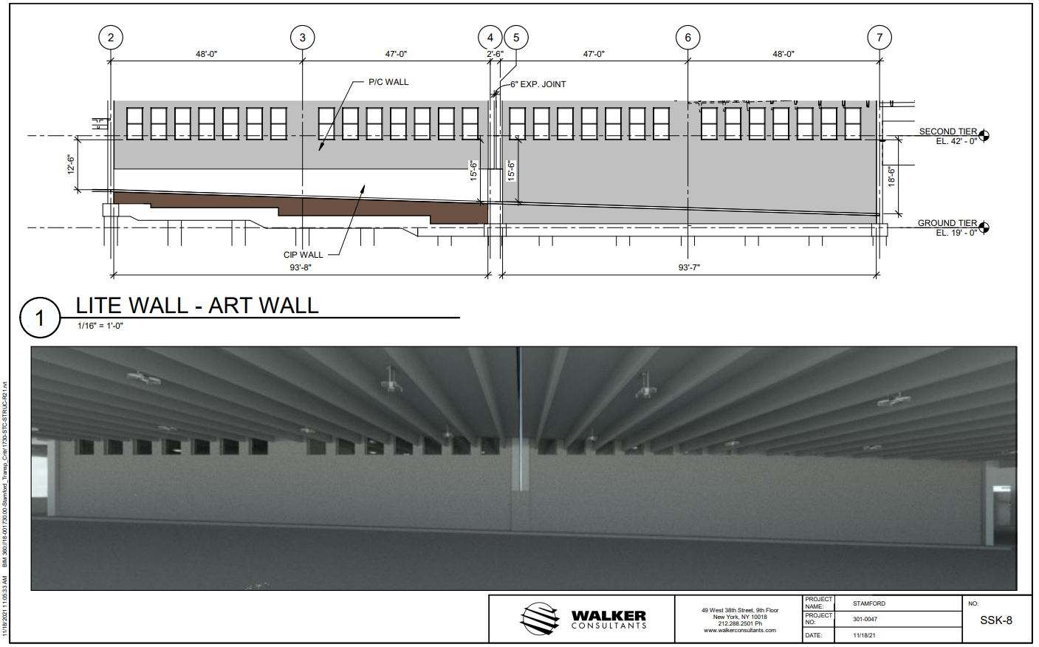
South State Street
Lite Wall – Art Wall
Renderings Provided to the City to Develop the Arts Program in November 2021

Slide 6
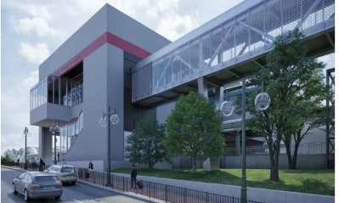
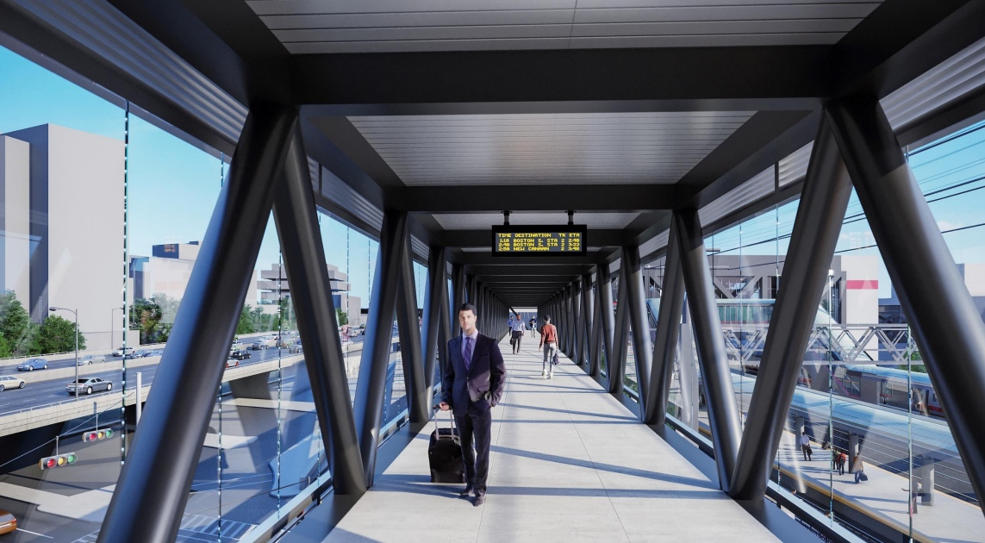
Pedestrian Bridge
Connecting the New Parking Garage to the Train Station
320 Feet Long, Enclosed in Glass
Supported by 3 Piers

Slide 7
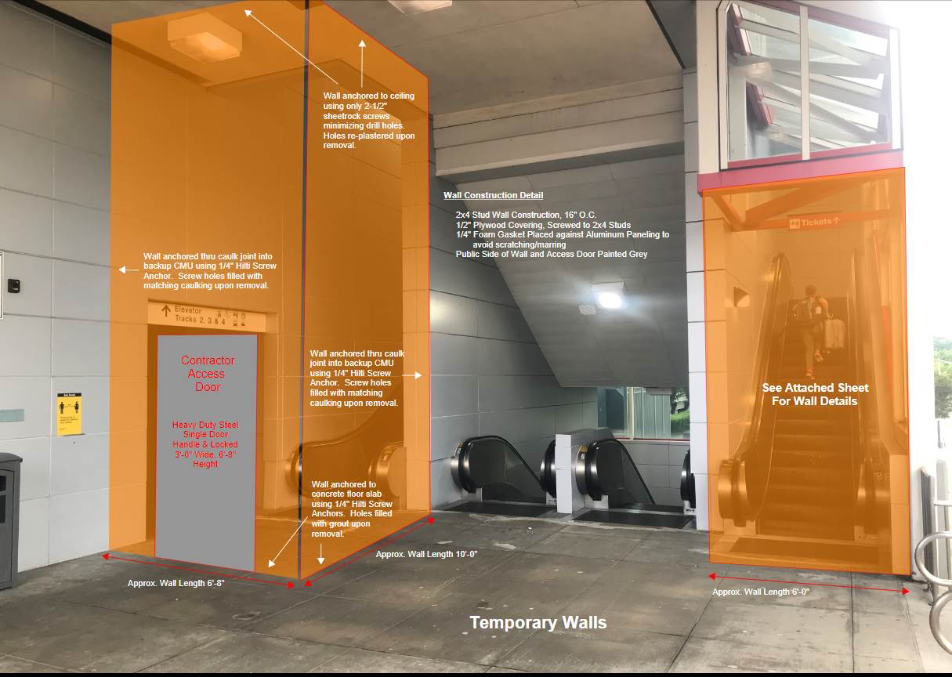
Connection to STC
Temporary closure of Escalator Nos. 3, 4, 7, and 8 to allow for Pedestrian Bridge Connection to STC
Escalator Nos. 1, 2, 5 and 6 to the Lower Level will remain operational during this period
Work planned to start June 2022 and re-opening of escalators in September 2022

Slide 8
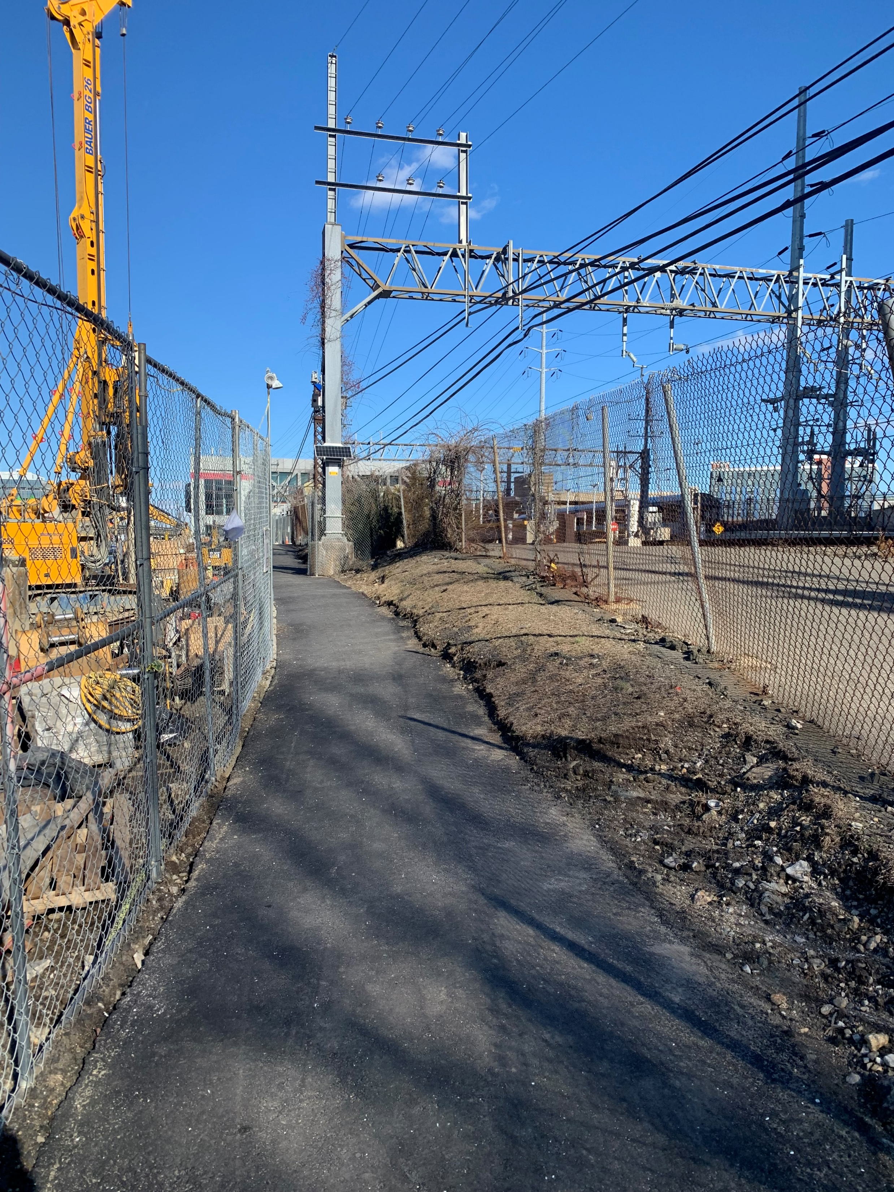
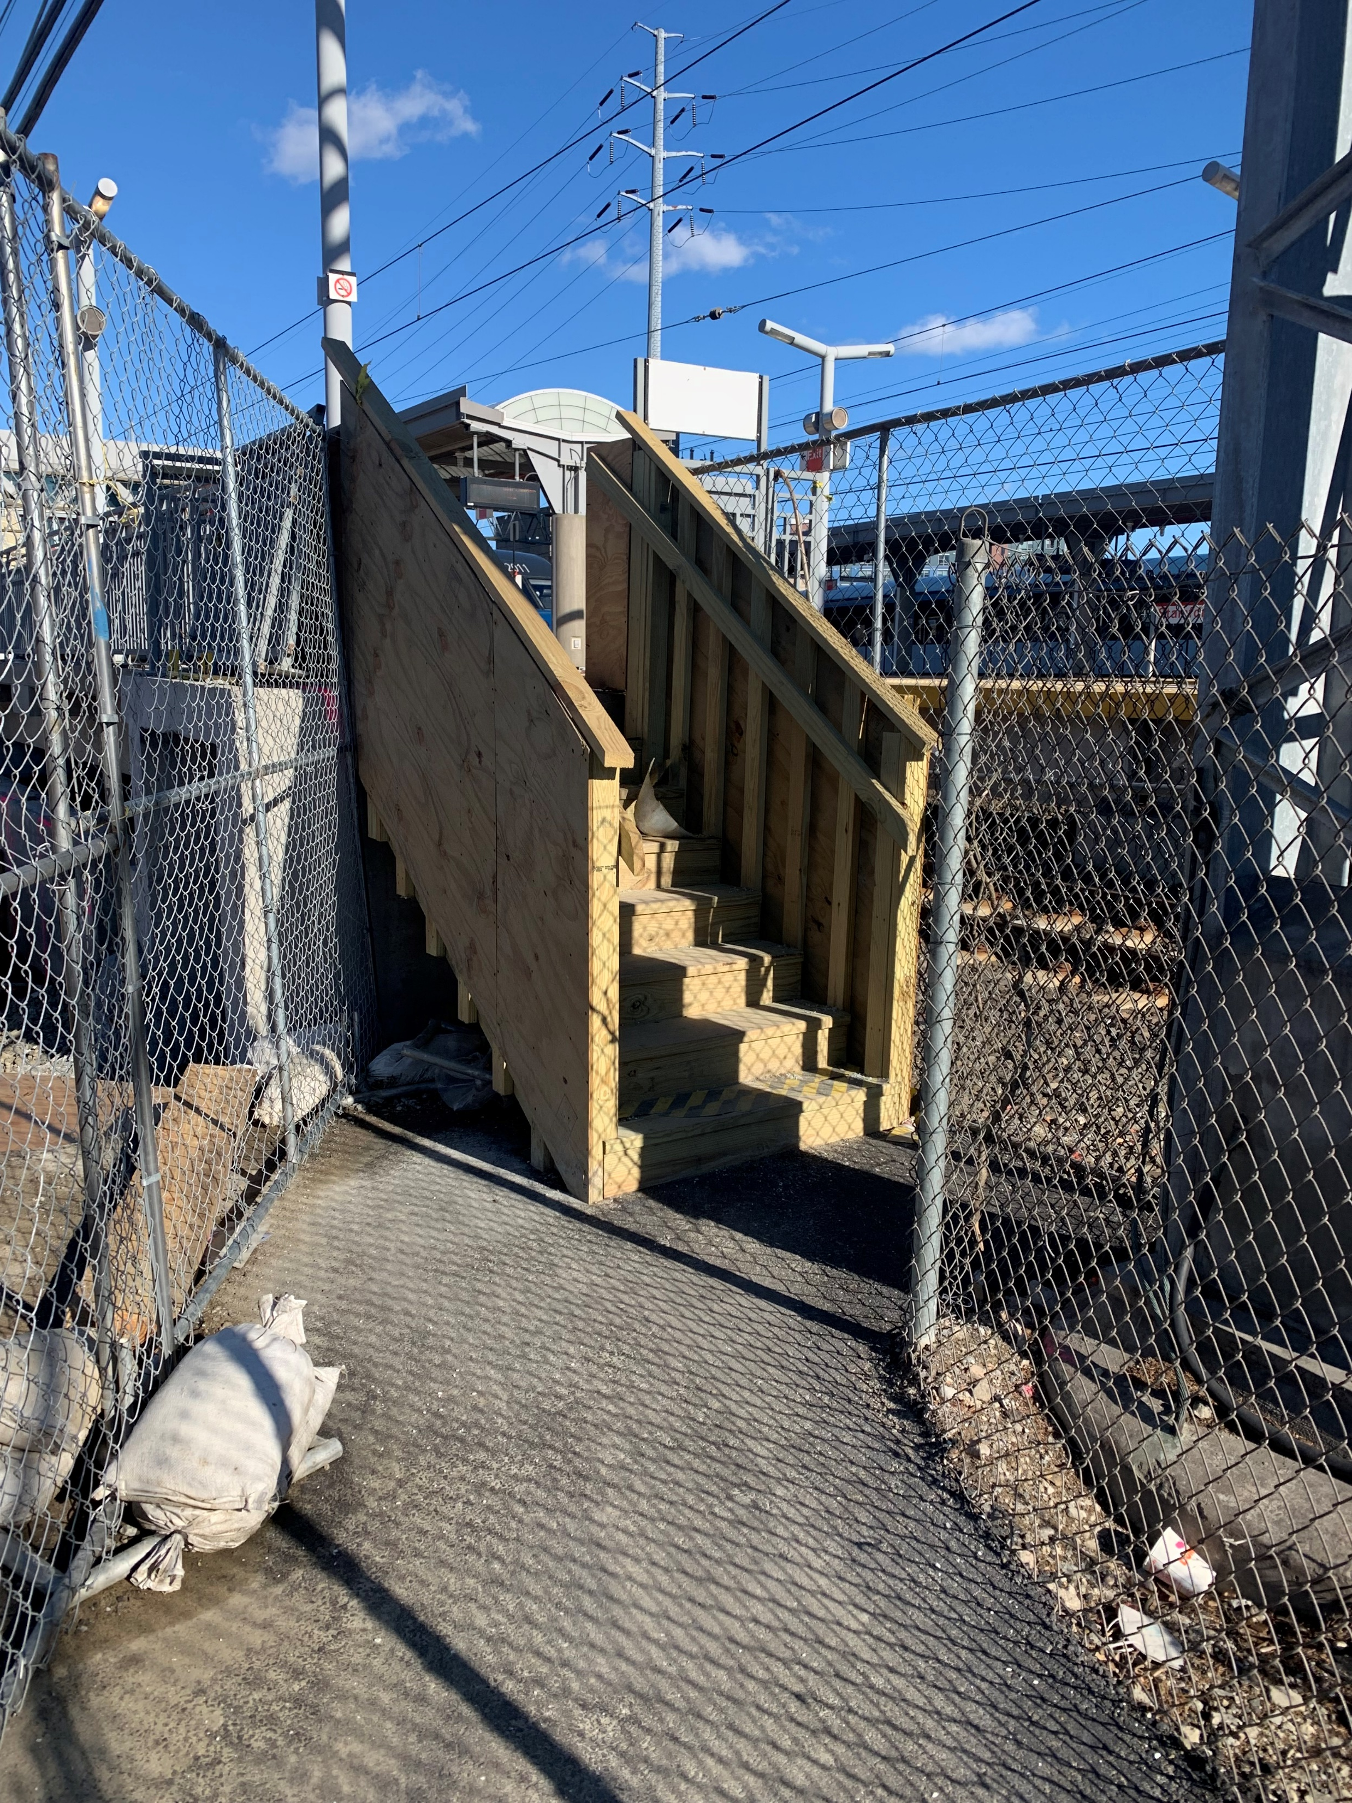
Pedestrian Access
Temporary paved pathway installed from Track 5 north platform to Greenwich Avenue
Allows pedestrian access during most periods during construction
Contract allows for access shutdowns during Precast Erection starting in May 2022, however, we are looking at ways to keep temporary pathway open
Temporary pathway view east
Temporary stairs to Platform

Slide 9
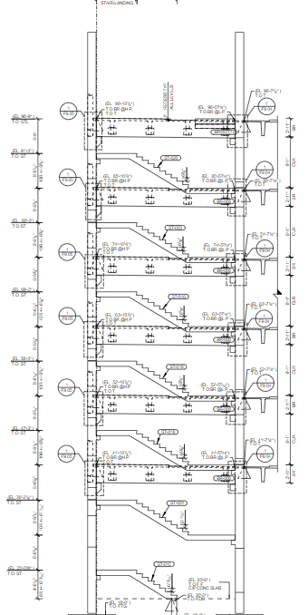
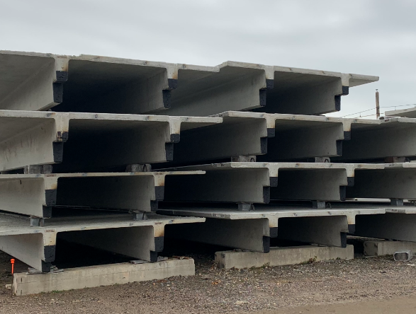
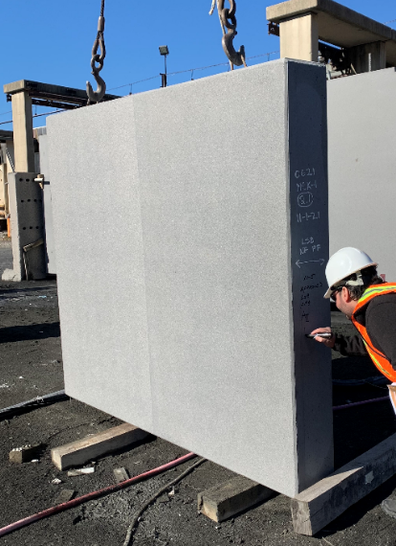
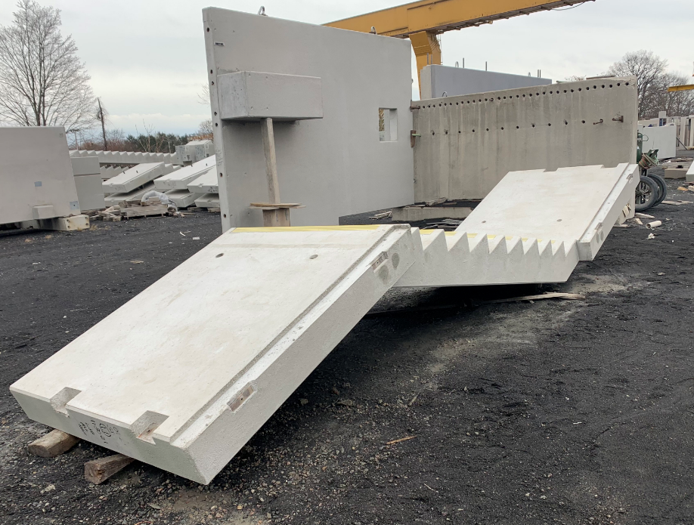
Upcoming work
Precast Fabrication: Fabricator Blakeslee has finished about 60% of fabrication and ongoing
South Wall 102 to be constructed along with micro-pile work and Pedestrian Bridge foundations in late March
Precast Erection: Starting in Early May 2022
Southeast Stair/Elevator Tower 1: 100 feet tall tower to be erected at the same time as the 2nd bay of the precast erection, expected to start in June 2022

Slide 10
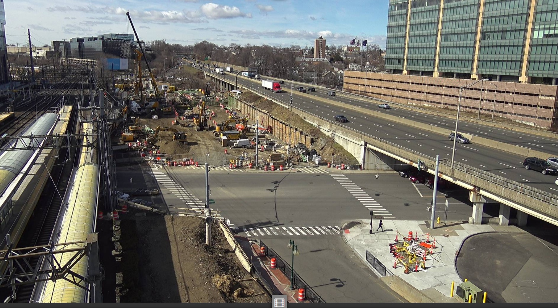

Slide 11
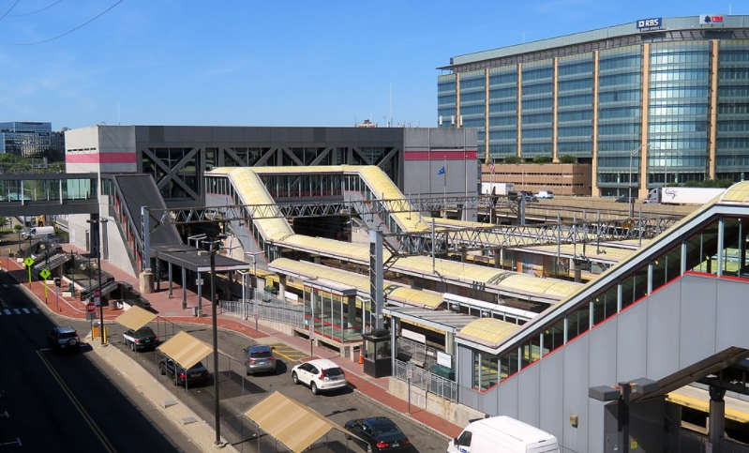
Elevator and Escalator Improvements
Upgrades to five elevators
Replacement of critical components
Increased performance
Updated aesthetics
Upgrades to 17 escalators
Replacement of all mechanicals
Improved performance
Increased efficiency
Up-to-date safety features
Contractor: O&G Industries
Notice to Proceed: December 2021
Completion: August 2024

Slide 12
Elevator and Escalator Improvements
Surveys of Existing Elevators and Escalators is Complete
Shop Drawings being prepared for procurement
Stage 1 (Aug22) – Elevator 7 & Escalator 16
Stage 2 (Nov22) – Escalators 9,13,15
Stage 3 (Feb23) – Elevator 2 & Escalator 12
Stage 4 (May23) – Elevator 3 & Escalator 14
Stage 5 (Aug23) – Elevator 1
Stage 6 (Nov23) – Elevator 4 & Escalator 10
Stage 6/7 (Nov23) – Escalators 5-8
Stage 7 (Feb24) – Escalators 11 & 17

