Slide 1
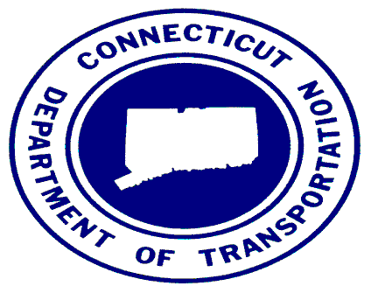
Waterbury Line Update December 21, 2020

Slide 2
Agenda
Introductions and Opening remarks
Follow-up from January 13, 2020 Presentation
Capital Improvements
Waterbury Station Improvements
CT2030
Operations
Waterbury Line Master Improvement Plan

Slide 3
Follow-up From January 2020 Presentation
From our meeting on January 13, 2020, we’re here to update you on the progress of the construction and operating plan.
Since our meeting in January, COVID-19 has impacted us in the following ways:
We took advantage of the reduced ridership, so we bused the line from April to November.
Substantial progress in the project was the result of this train service outage. Completion of the work is on schedule for December 2021.
Ridership on the main line dropped by 95% and on the Waterbury Line by 91%. We are currently working with MNR on future service plans that will support this reduced ridership that could take 3 years to restore to pre-COVID levels.

Slide 4
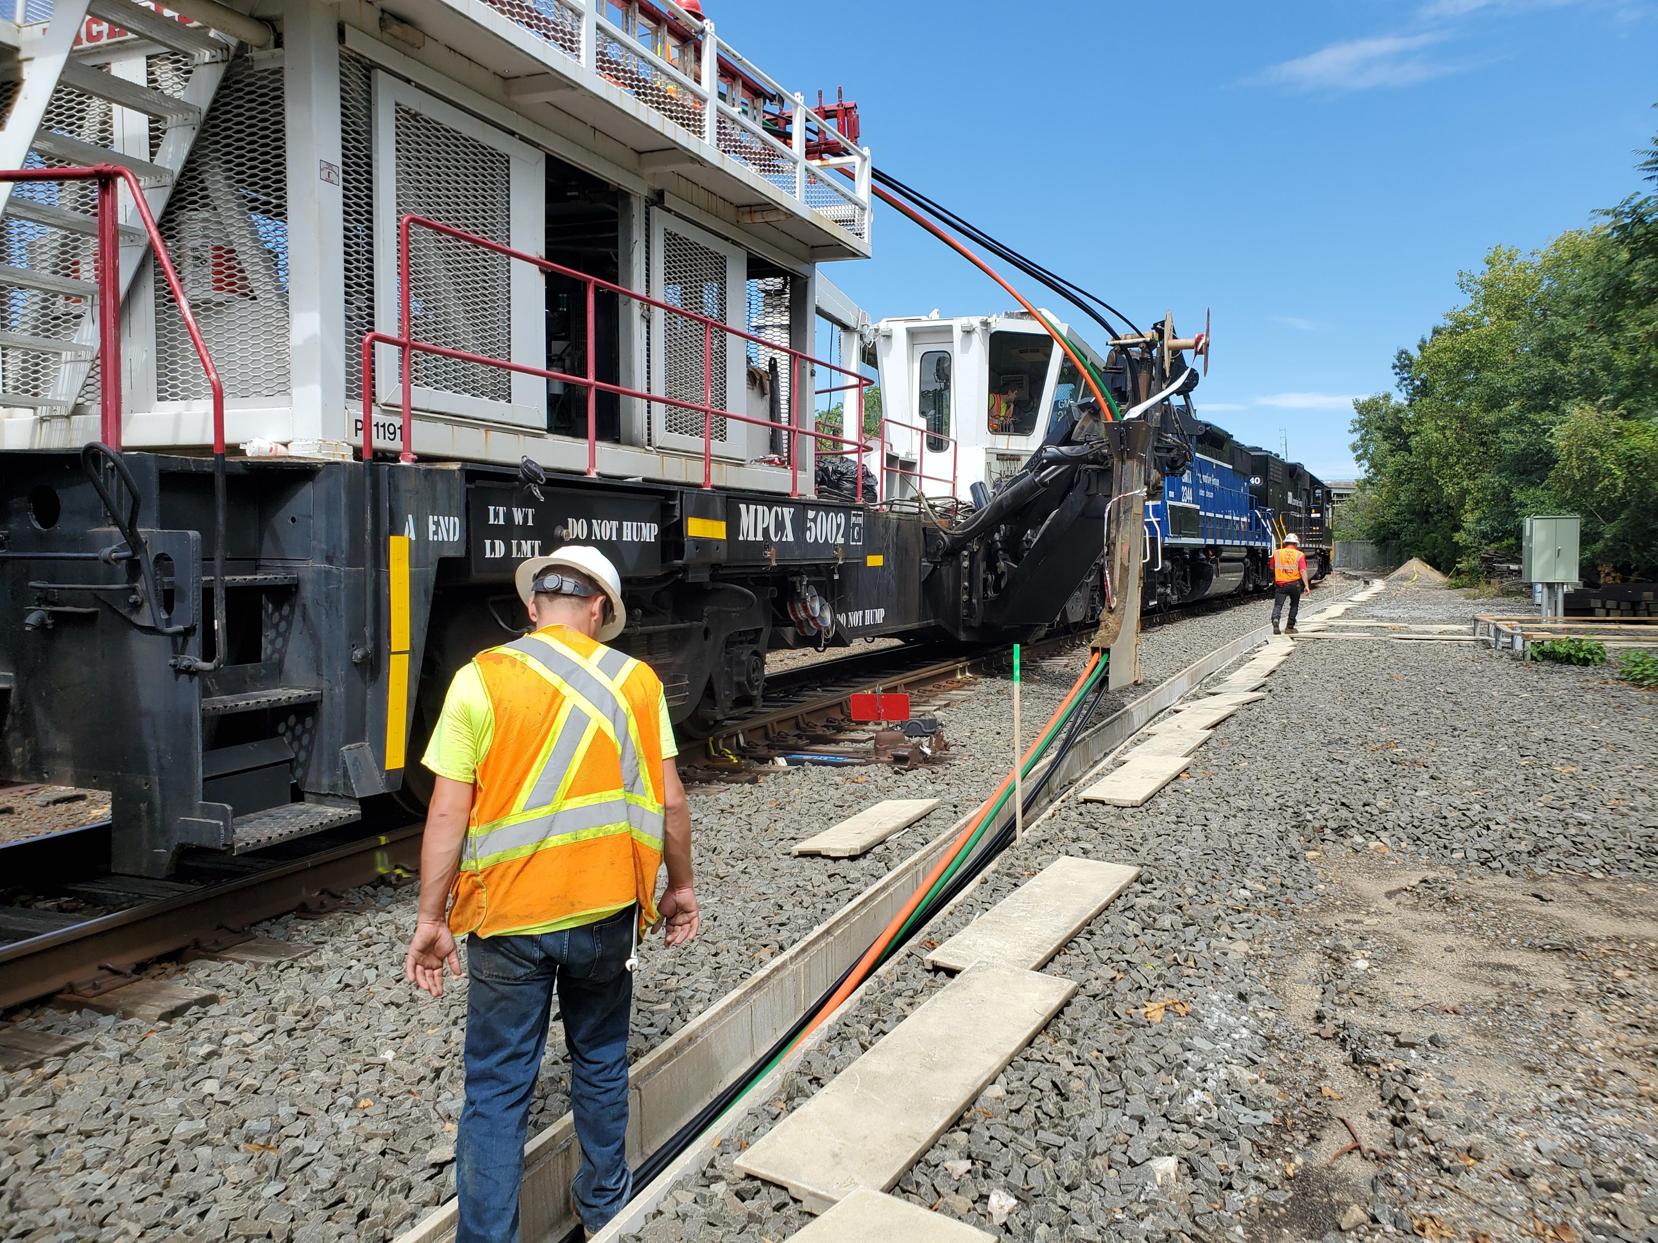
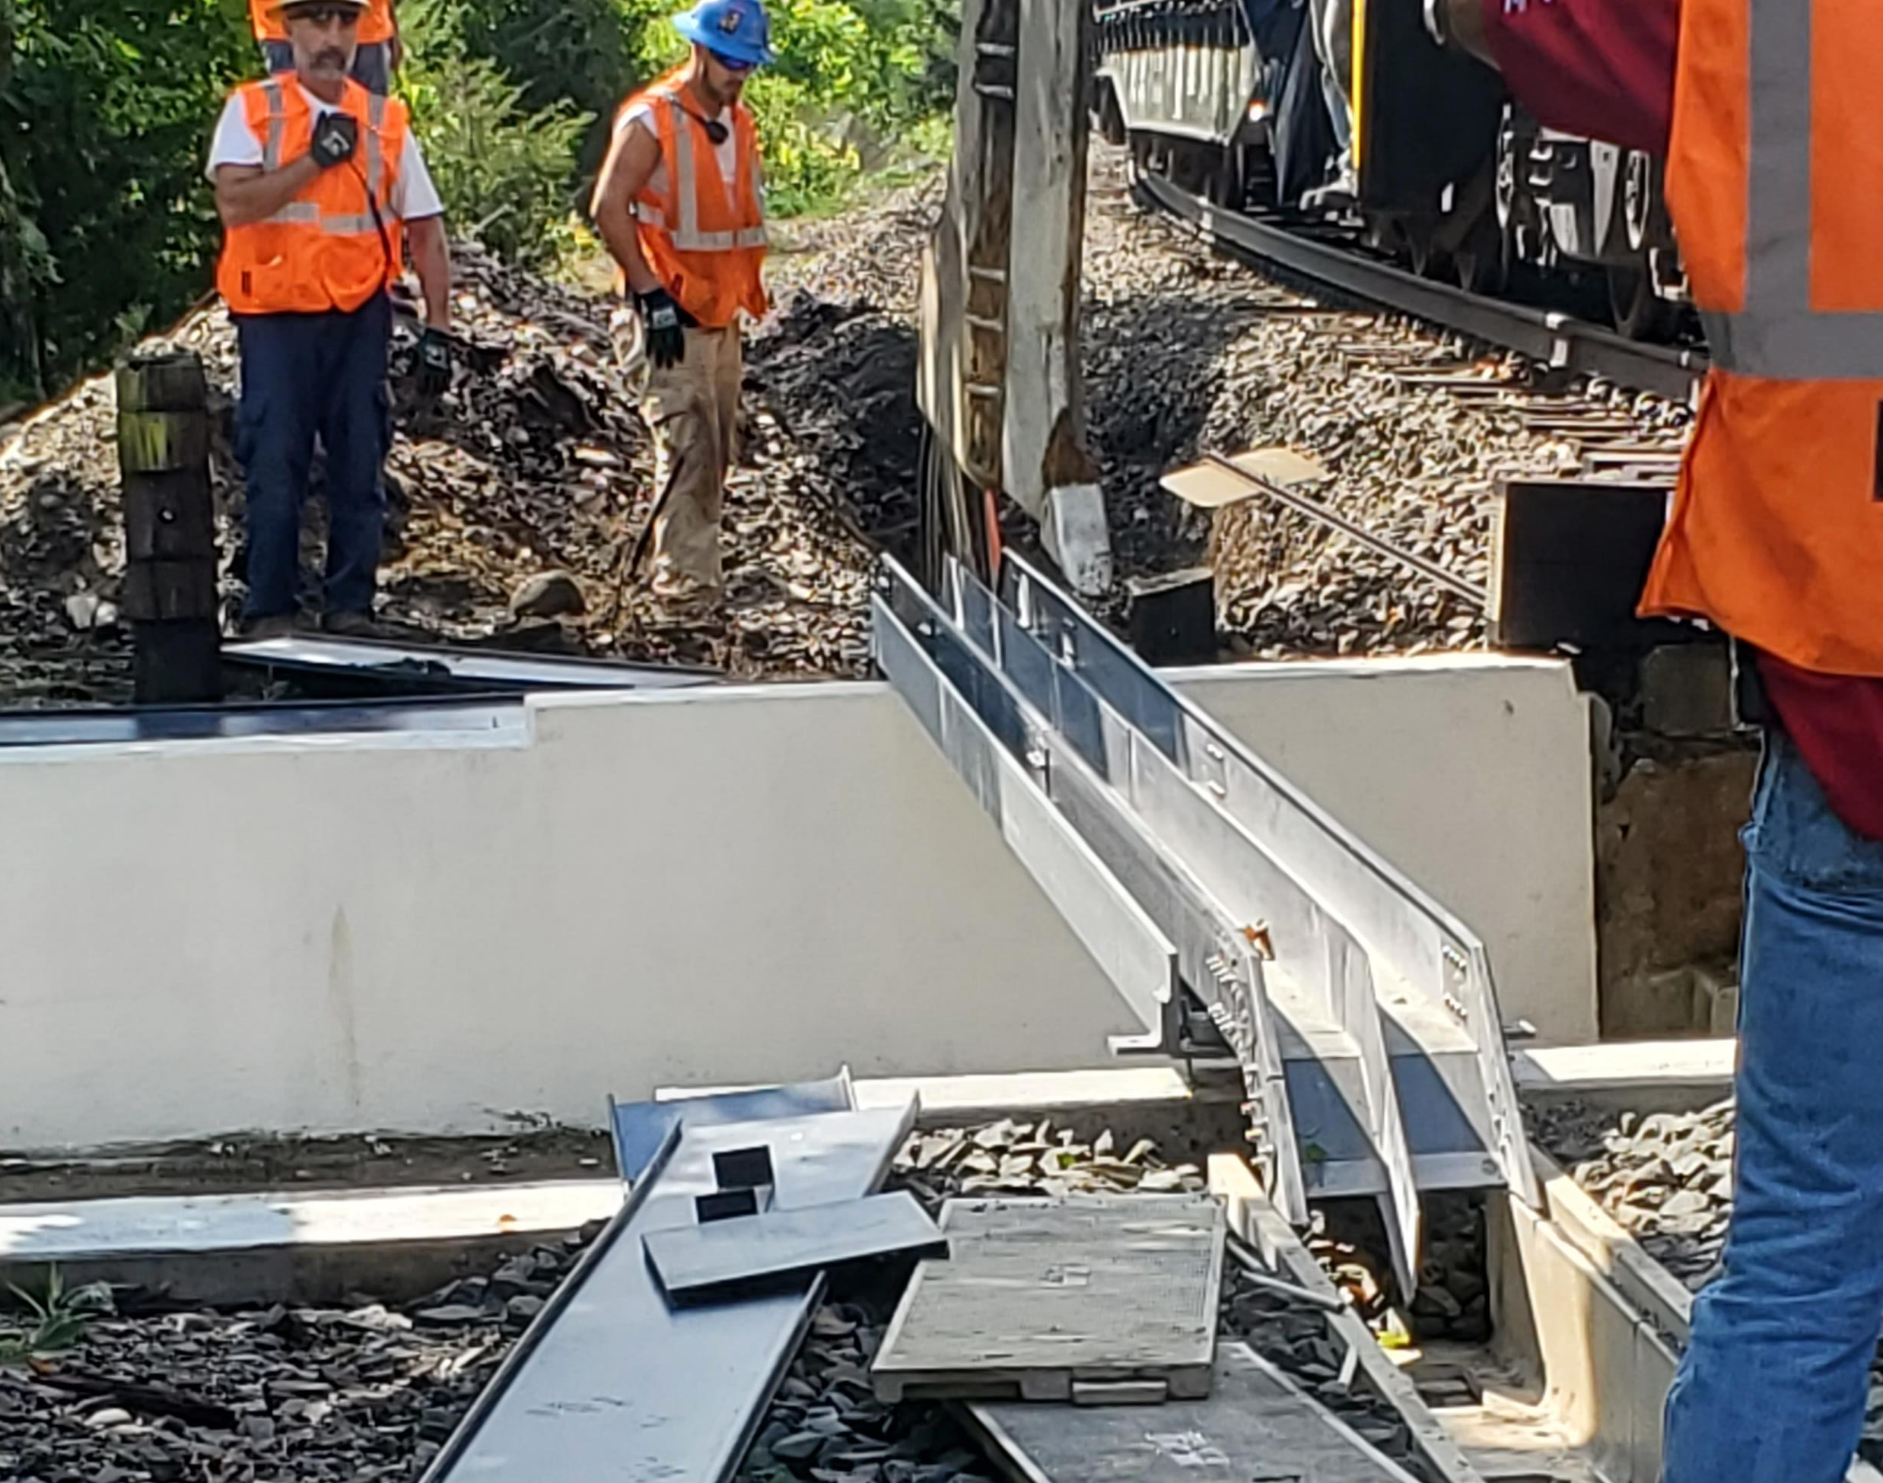
Capital Improvements
Work completed in 2020
Upgraded Signal and Communications System
Track Improvements
Installed new Rail Sidings
Bridge Repairs
Derby
Seymour
Naugatuck

Slide 5
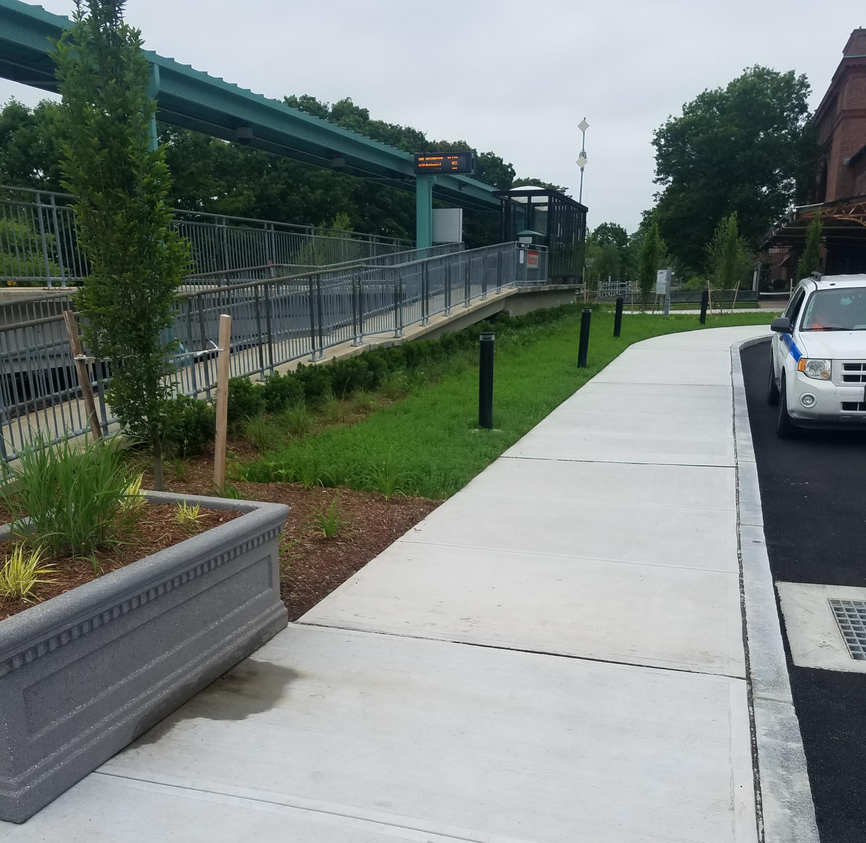
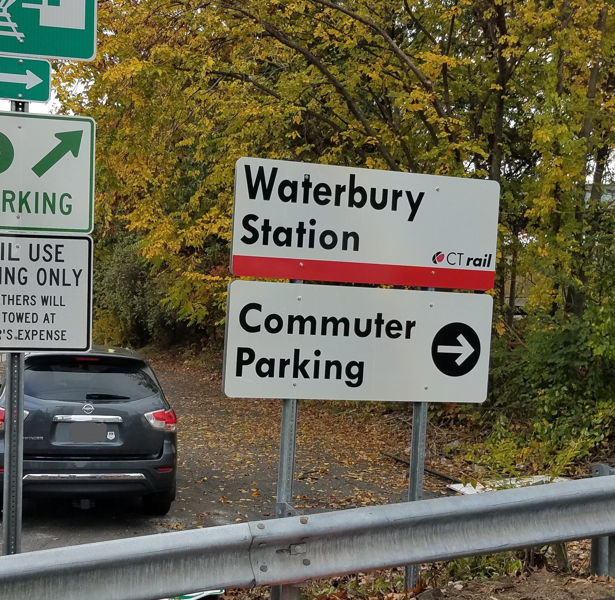
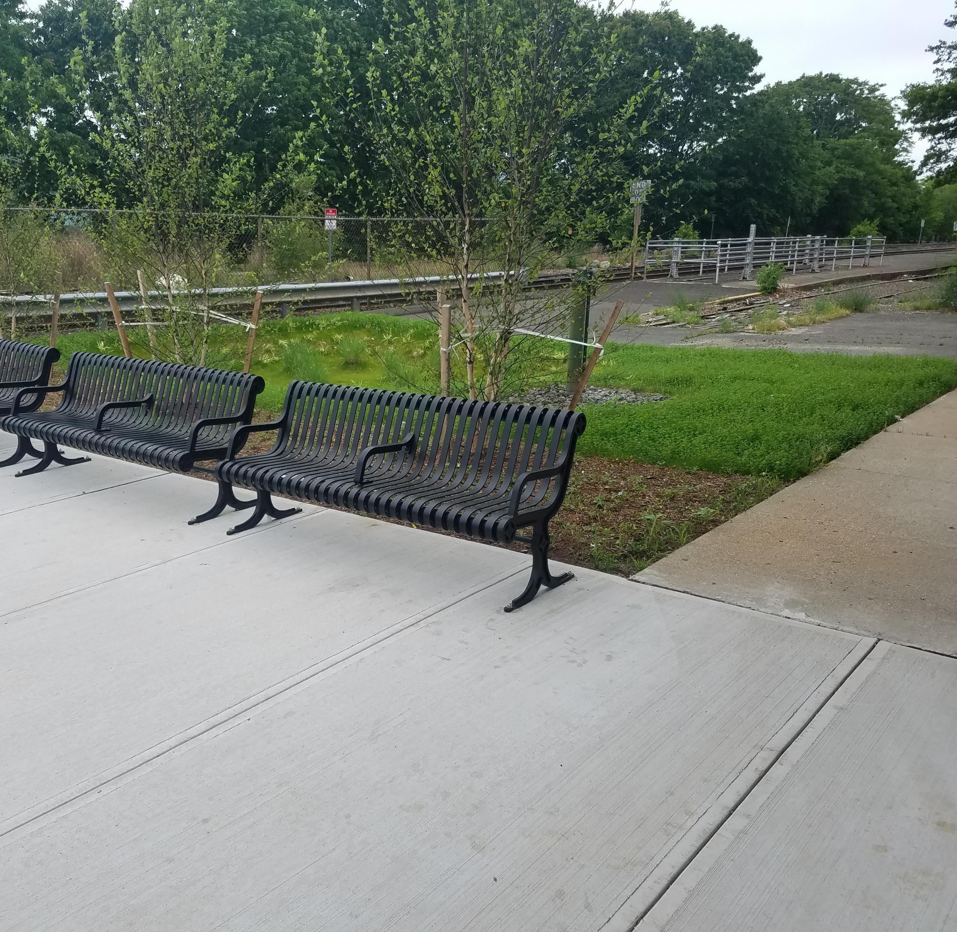
Waterbury Rail Station Improvements
New Signage
Improved Landscaping
New Pavement
Four pre-wired slots for future EV charging stations
New benches and sidewalk

Slide 6
Waterbury Line CT2030
Near-Term Enhancements by 2022
Cab signalization and full Positive Train Control (PTC)
Start design for high-level platforms with programmed funding in 2023 of $15 million
Increase weekday peak and off-peak train service

Slide 7
Waterbury Line CT2030
Mid-Term Enhancements by 2026 (Subject to Funding)
Contract option for new rail cars
Construct high-level platforms
Station enhancements
Additional off-peak train service including direct service to Stamford and NYC

Slide 8
Waterbury Line CT2030
Long-Term Enhancements – 2027 and Beyond (Subject to Funding)
Additional rail cars, new dual-mode locomotives
More service to Stamford and NYC
Station improvements

Slide 9
Operations
Current Service Levels
13 trains – Service operating approximately every 3 hours
Two buses departing Bridgeport during the PM peak hours on weekdays, starting Nov. 30th , light ridership
Ridership has dropped considerable from COVID-19
Potential Near-Term Enhancements (Subject to Funding)
Increase the AM Peak and PM Peak period trains by 1st quarter 2022
Increase the off-peak train service
Increase the weekend train service

Slide 10
Waterbury Line Master Improvement Plan (Service)
Expected start date March 2021
Rail operations simulation model using RTC software to determine what the maximum operating density would be on the Waterbury Line with incremental upgrades
Identify the limitations and capabilities of the existing service on the Waterbury Line
Examine the near term (to 2023), mid-term (to 2030) and longer-term (beyond 2030) planning horizons, with the focus on identifying options for service enhancements
Optional market assessment that will examine the rail travel market including identification of the current and future projected travel patterns, ridership and demands

Slide 11
Waterbury Line Master Improvement Plan (Equipment and Infrastructure)
Identify the limitations and capabilities of the existing equipment, infrastructure and facilities on the Waterbury Line
Evaluation of the rail storage and maintenance requirements to support near-term, mid-term and long-term service enhancements
Examine the near term (to 2023), mid-term (to 2030) and longer-term (beyond 2030) planning horizons, with the focus on identifying options for equipment and infrastructure/facility enhancements

Slide 12
Closing Comments

