Slide 1
2020 COVID19 UPDATES Maintenance of Way Division
Track, Structures, Stations & Facilities
Metro-North Railroad
June 4, 2020

Slide 2
Major Track Outage Highlights
GCT
Track dept. cleaning the Lower Level while OOS
Took 4 tracks at a time on the lower level to clean and tackle misc. track conditions (tie plates, block tie etc.) See slide 8
Replaced 745/705 switchpoint and stock rail on Ladder T on a continuous outage
Would have worked 1 extended, overnight shift but because LL is closed we can take it OOS and work over 3 days. See slide 8
Mott Haven
Tested all of MO territory with SRS129 in record time. See slide 7
80% of territory could be done on days without night outages due to current schedule.
Surfacing CP 5 See slide 6
Hard outages to get due to exchange between Hudson and Harlem, we were able to take 20 hour windows to surface 13A, N24B, 45, 47 switches all surfaced last week
Sandy Contractor (Trk 1 between CP 6 and CP 8, Trk 2 CP 10 to CP 11) and Harlem Express Contractor (Trk 2 CP 112 to CP 212 and Trk 3 inside CP 112) granted continuous outages that would have taken multiple weekends of force account support.

Slide 3
Major Track Outage Highlights
Hudson
Rail jobs: 37 curve high and low side on both tracks 2 and 1 were completed by NY Projects, Scheduled for later in the year but completed now due to workforce reductions in MoW. See slide 5
Sperry testing: Both POK and Harmon track will have their entire subdivision tested in record time – both a product of the current operating schedule and frequency of testing. See slide 7
Built Cortlandt temporary platform much quicker and less track outages required. See slide 12
Hudson Express cable contractor work continued with no impacts to schedule
Harlem
CP 119 Switch Renewal: not on original 2020 plan but pursued due to limited ridership and the ability to secure use of the Parking lot adjacent to CP 119; Outage was also taken continuous due to the operating schedule which drastically cut down on the expected duration
HA 19.35 bridge timbers replacement. See slide 10
This was an extra job that was not in the plan for 2020, would have been really tough and probably 4 weekends of work. Work completed in a 7 day period
Harlem express cable CP 130 to CP 136: Planned as weekend and night work during 2020. Took it continuous instead due to the whole workforce reduction issues with Power/Signal
Wassaic bridge work: Weekend service cancelled and no busses provided due to ridership. Track dept. replaced and surfaced a GEO hit on muddy river bridge

Slide 4
Major Track Outage Highlights
New Haven
Springdale track welding inside CP 217 and CP 216 that would have been night work done during the day due to less trains and being able to single track
Geometry condition on the crossover at CP 216, was a much easier fix with almost no Amtrak trains running and less time to fix was needed
Trk 1 CP 217 to CP 223 removed from service for tie condition See slide 5
Westport station – Utilized track 3 outage to cut and extend station platform See slide 11
Springdale track record time to test subdivision with SRS129. Outside tracks included all on daytime hours. Operation was able to single track without bridge plates to expedite testing. See slide 7
Branch outages: Planned for later in the year but taken now due to limited ridership. See slide 5
Danbury Branch continuous outage for ties, crossing renewal, bridge timber replacement and cycle surfacing
Waterbury Branch continuous outage for ties and Signal contractor
Mudspot SMARTrack outage on track 2 between CP 266 and CP 271, will run railvac and CWPs out there to address multiple mudspots. See slide 5
CP 234 46A and 46B switch replacement complete, moving on to the 68 and 810 switches. This outage would have again been very difficult operationally because it closes Stamford yard. Thus far, this 7 day outage continuous outage has removed 6 weekends of work with little impact to the operation. See slide 6

Slide 5
Track Projects
Production Tie Replacement – 11,845 during COVID19
¤ |  | Danbury |  | 5,862 | ties installed - May 19 - Present
¤ |  | Waterbury |  | 7,300 | ties installed - April 13 - May 6
 |  |  |  | 13,617 | Total ties installed
Production Mini Tie Replacement – May 2, 2020 – May 31, 2020
¤ |  | Harlem |  | 423 | ties installed - Mt. Vernon West Yard
¤ |  | New Haven |  | 1,143 | ties installed - CP217 - CP223
 |  |  |  | 1,566 | Total ties installed
Rail Replacement
¤ Hudson, Trks 1 & 2 Curve 37 1.2 miles completed
Railvac-SmarTrack
¤ New Haven – Trk 2, CP266 – CP271 began vacuuming out debris and dirt in between ties.

Slide 6
Switch Renewal – 7 switches installed during COVID19
¤ | New Haven | 46 A/B Switch Installed
¤ | WB | CP517, CP518, Beacon Falls Siding, CP500, CP502
Grade Crossing Renewal – 1 Installed During COVID19
¤ Harlem Line 1 crossing Jay St. Installed May 30th & 31st, 2020 and June 6th & 7th, 2020
Surfacing – 12.1 miles during COVID19
¤ |  | Hudson | 1.7 | miles
¤ |  | Harlem | 1.7 | miles
¤ |  | New Haven - NY | 0.2 | miles
¤ |  | New Haven - CT | 1.2 | miles
¤ |  | New Haven - WTBY | 5 | miles
¤ |  | New Haven - Danbury | 2.3 | miles
 |  |  | 12.1 | Total miles

Slide 7
Ultrasonic Rail Testing – 410 total miles during COVID19
Sperry Rail 129
Sub 7 (NHL) March 16, 2020 – March 31, 2020
Tested 47.0 miles
Sub 6 (NHL, DB, NC) April 3, 2020 – April 24, 2020
Tested 150.0 miles
Sub 2 (HAR) May 4, 2020 – May 8, 2020
Tested 49.0 miles
Sub 3 (HUD) May 11, 2020 – Present
Tested 97.0 miles
Sperry Rail 943
Sub 4 (HUD) April 29, 2020 – May 13, 2020
Tested 94.0 miles
Sub 8 (PJL) May 18, 2020 – May 21, 2020
Tested 90.0 miles

Slide 8
GCT Station Track Rehabilitation
Track 15
339 regular ties
70 bracket ties
409 total ties
818 5 ½ inch Pandrol plates
1,636 Pandrol Clips
375 tons of new ballast
3rd rail replaced the 3rd rail and will install new 3rd rail capping.
GCT
Track 102 – 106, Tracks 107-110, Track 111-114 – (In progress)
Replace switchpoint and stock rail on Ladder T on a continuous outage, again would work 1 overnight shift but because LL is closed we can take it OOS and work over 3 days

Slide 9
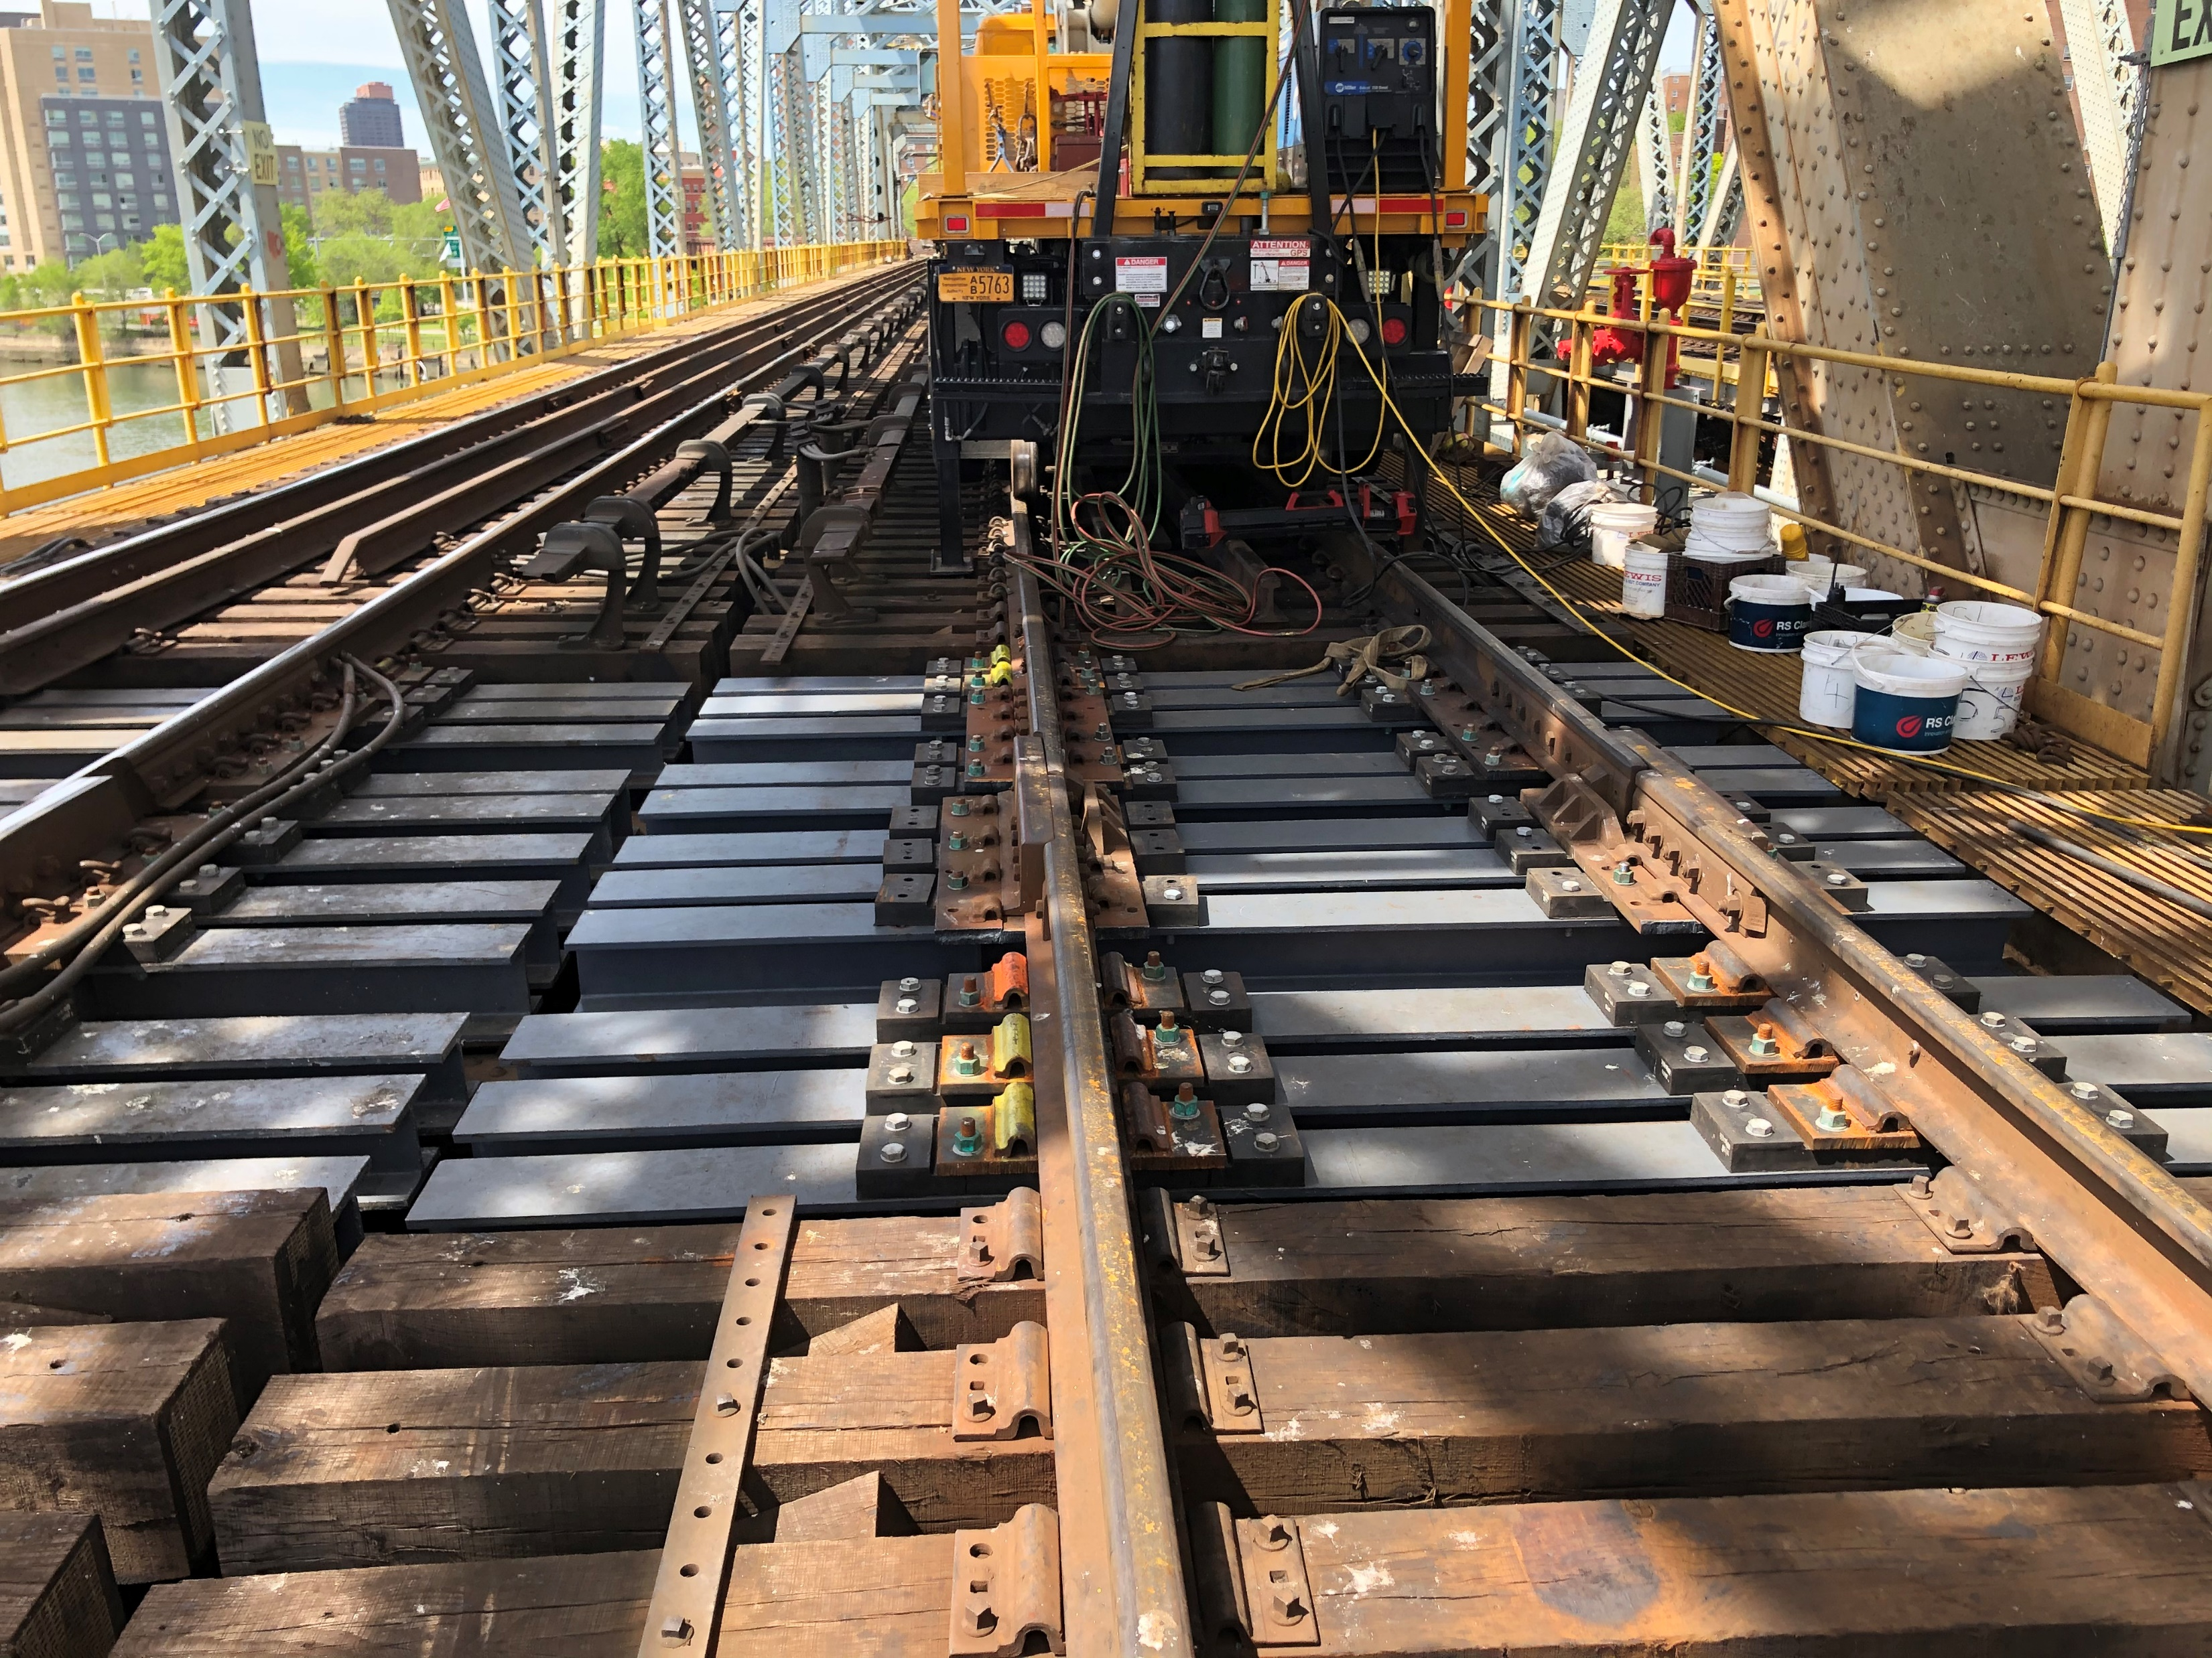
Structure Projects
Accomplishments with the additional track outages that were granted during the Covid-19 crisis.
Expedited HRLB Miter and Expansion Joint Installations. As part of that project, a total of 120 steel ties are being installed to replace existing timber ties and to support the new joint assemblies.
During the last few weeks we have been able to obtain favorable continuous outages from OPS which has increased our ability to get work done. Within a one month period we will have installed the last remaining 41 steel ties that would normally have taken us 16 to 18 weekend outages (say 4 months) to complete.

Slide 10
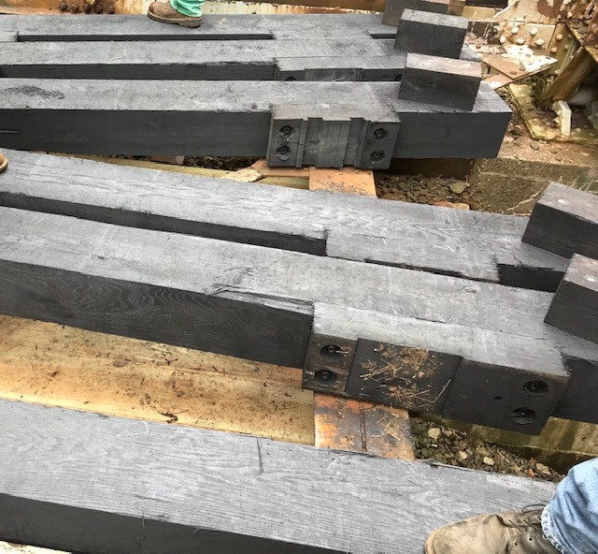
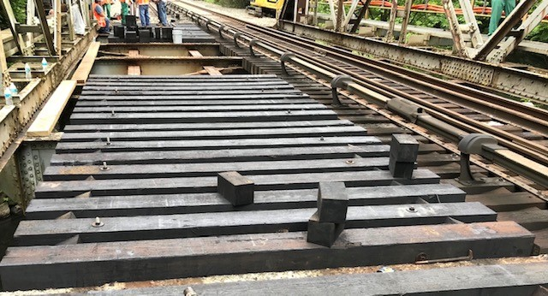
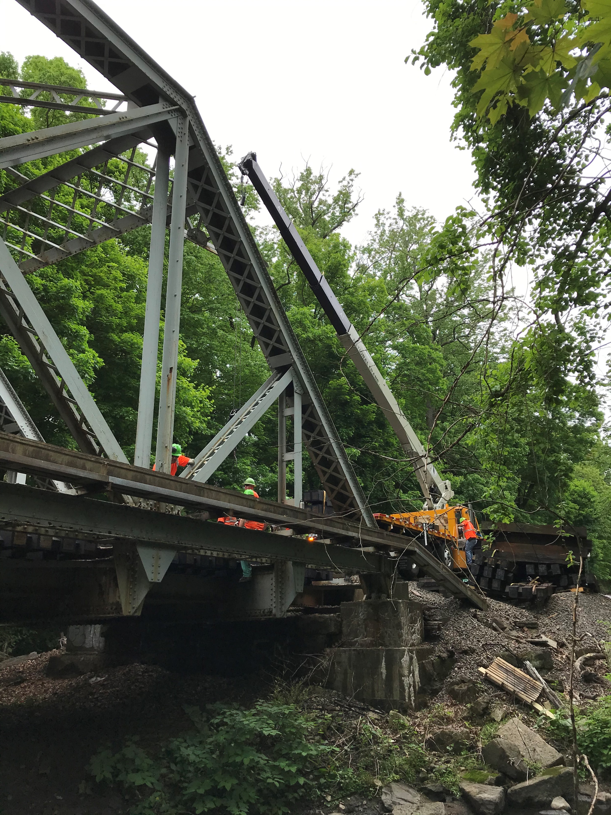
Harlem Line Deck Replacement Trk 1, MP 19.35
Replace, Track 1 Bridge Timbers on the 100’ long through truss at HA19.35. completed week of May 25, 2020. Demobilization occurred May 30th and 31st, 2020
Crane
North Bay Timbers
Deck Replacement

Slide 11
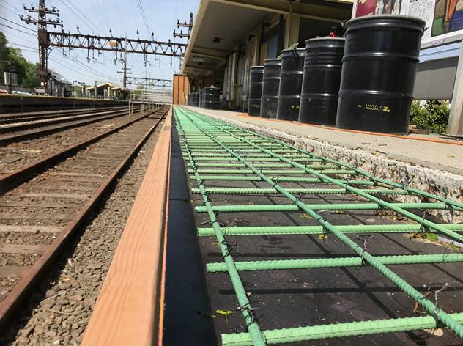
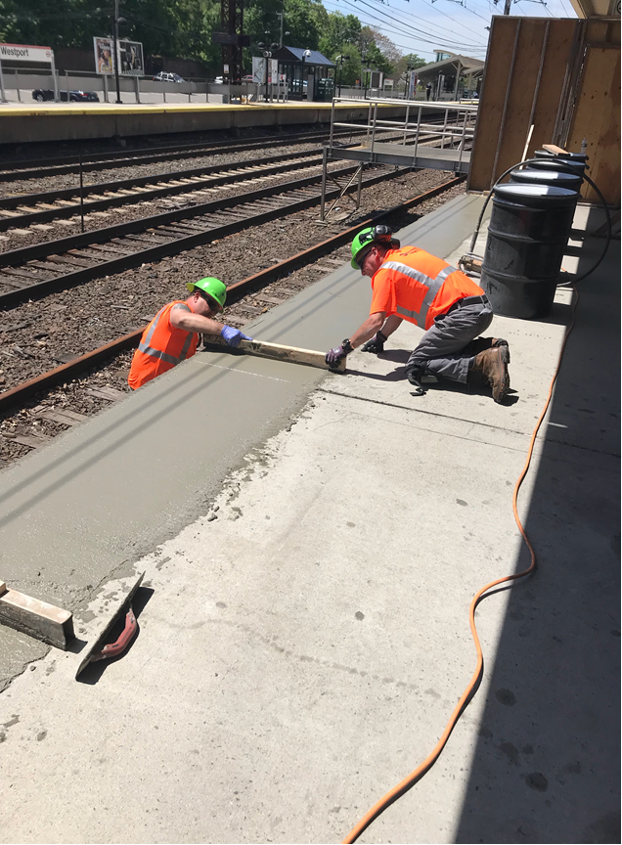
New Haven Line Westport Station
Sawcut two feet of platform edge, installed new rebar and concrete and successfully corrected the platform edge gap conditions

Slide 12
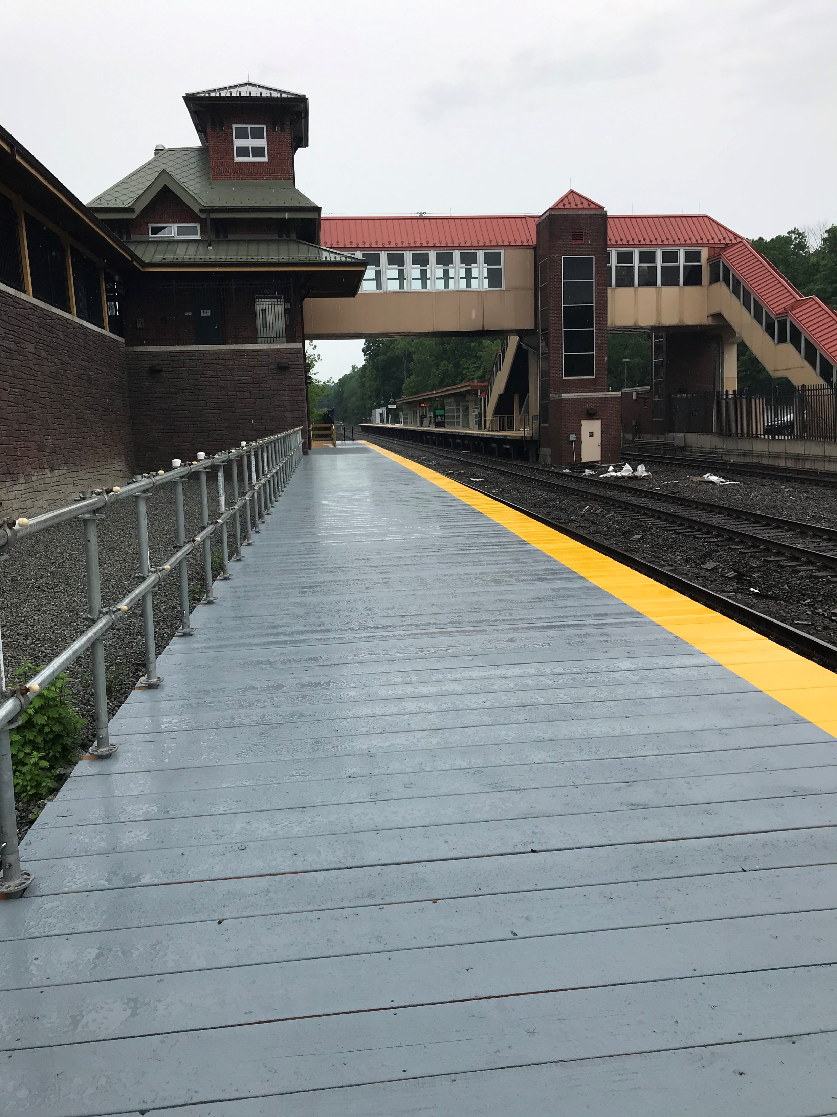
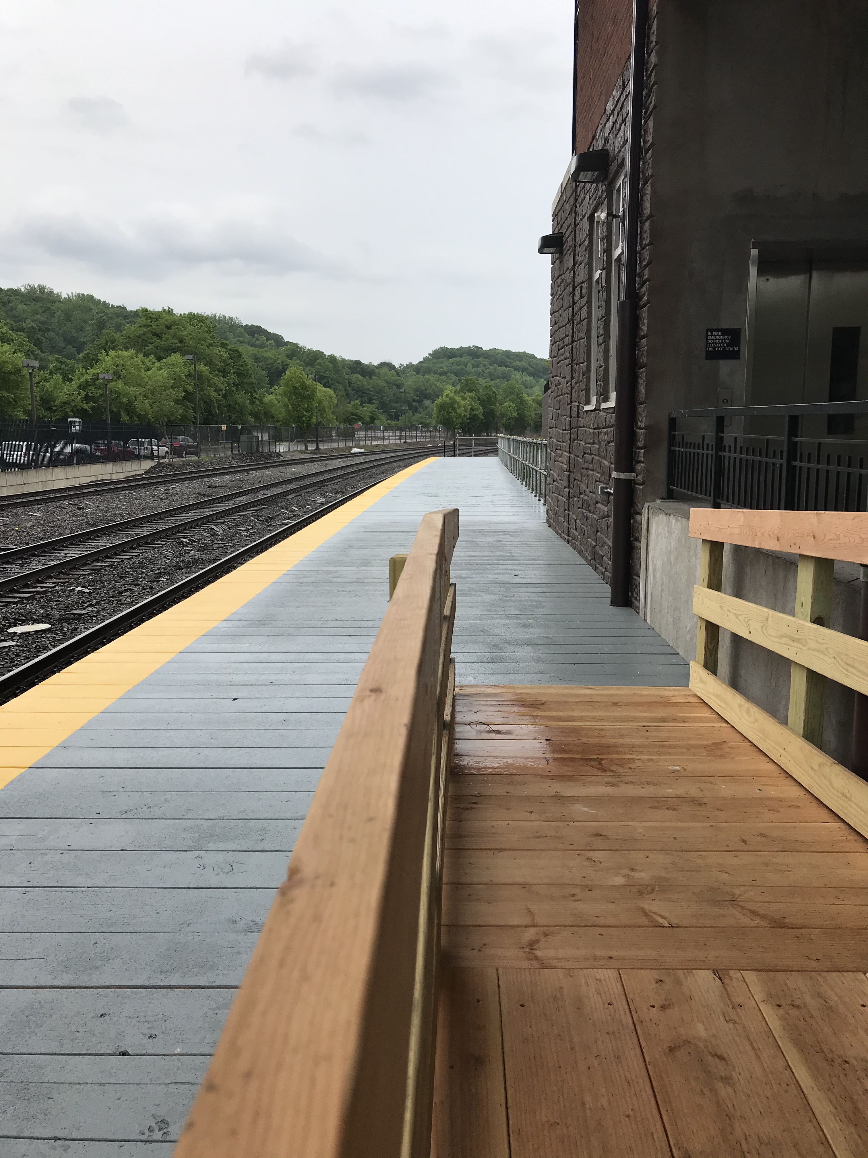
Hudson Line Cortlandt Station
Installed platform to extend over to the track to board customers during extended track outages for other projects

Slide 13
Drainage work
(In progress) Performed ROW drainage improvements project south of Poughkeepsie Station between HU MP 73.22 (OH Mid-Hudson Highway) and MP 73.46 (OH Main Street).
Pumped/removed water from ROW, cleaned ROW, spread stone, located drainage structures and opened-up drainage swales. Worked with Fred A. Cook to clean drainage ditches, catch basins and pipes.
Performed ROW drainage improvements (re-establish existing swales) project to support Capital Department on the Port Jervis Line between MP JS 62.3 and MP JS 62.6.
Worked with Fred A. Cook to clean catch basins, drainage pipes, and slot drains at Beacon Station parking lot (Hudson River side) to support Capital Department for future repaving.
Inspected Hudson Line (MP 61 to MP 73) culvert inlets/outlets and cleared blockages where necessary.
Cleaned the outlet of the culvert at HA MP 60.5 (Peckham Crossing) in support of Track Department high water concern.
Removed debris accumulation at the inlet to the new drainage pipe at Dykemans crossing in Brewster, NY.
Inspected/cleared Harlem Line recurring beaver dam obstructions.
Inspected and cleared blockages from various Port Jervis Line culvert inlets/outlets.
Removed beaver dam obstruction at inlet to culvert located at JS 47.28 (end of Bond Street, Central Valley, NY) in response to Trouble Ticket dated 5/21/2020.

